Slide 1
Applications of news analytics in finance
Notes:
Finance
Share market

Slide 2
Introduction
NEWS plays a key role in financial markets.
The sources and volumes of news continue to grow.
Machine learning techniques can be used to process the textual input of news stories to determine quantitative sentiment scores.
Applications of news, for prediction of abnormal returns, for trading strategies, for diagnostic applications as well as the use of news for risk control.

Slide 3
Impact of News on the Market Environment
News continually updates investor’s understanding and knowledge of the market and influences investor sentiment.
Traders and other market participants digest news rapidly, revising and rebalancing their asset positions accordingly.
Major news events → investor sentiment → rapid changes to the risk structure and risk characteristics of traded assets.

Slide 4
News Analytics
Financial news can be split into regular synchronous announcements (expected news) and event driven asynchronous announcements (unexpected news).
Textual news is frequently unstructured, qualitative data.
It is characterized as being non-numeric and hard to quantify.
Application of this news data will lead to improved analysis (such as, predictions of returns and volatility).
Process is extremely challenging.

Slide 5
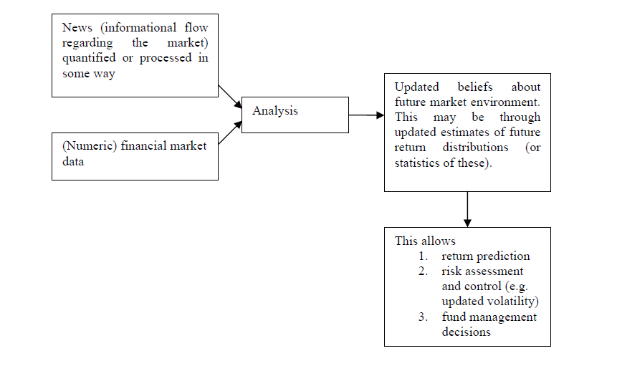
A simple representation of news analytics in financial decision making

Slide 6
Data sources
Four broad classifications of news (informational flows).
1. News
News stories produced by reputable sources.
2. Pre-News
This refers to the source data that reporters research before they write news articles.
It comes from primary information sources such as, Securities and Exchange Commission reports and filings, court documents and government agencies. It also includes scheduled announcements such as macro economic news, industry statistics, company earnings reports and other corporate news.
3. Rumours
These are blogs and websites that broadcast “news”, and are less reputable than news and pre-news sources.
4. Social media
These websites fall at the lowest end of the reputation scale.
Ability to publish “information” easy.
These can be dangerously inaccurate sources of information.
However, if carefully applied (with consideration of human behaviour and agendas) there may be some value to be gleaned from these.
At a minimum they may help us identify future volatility.

Slide 7
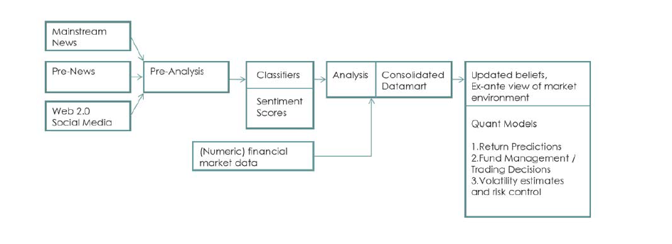
Information flow and computational architecture

